Slide 1


Getting to know AWS Serverless with CDK, Java and Python
#DeveloperCareerDay2023

Slide 2
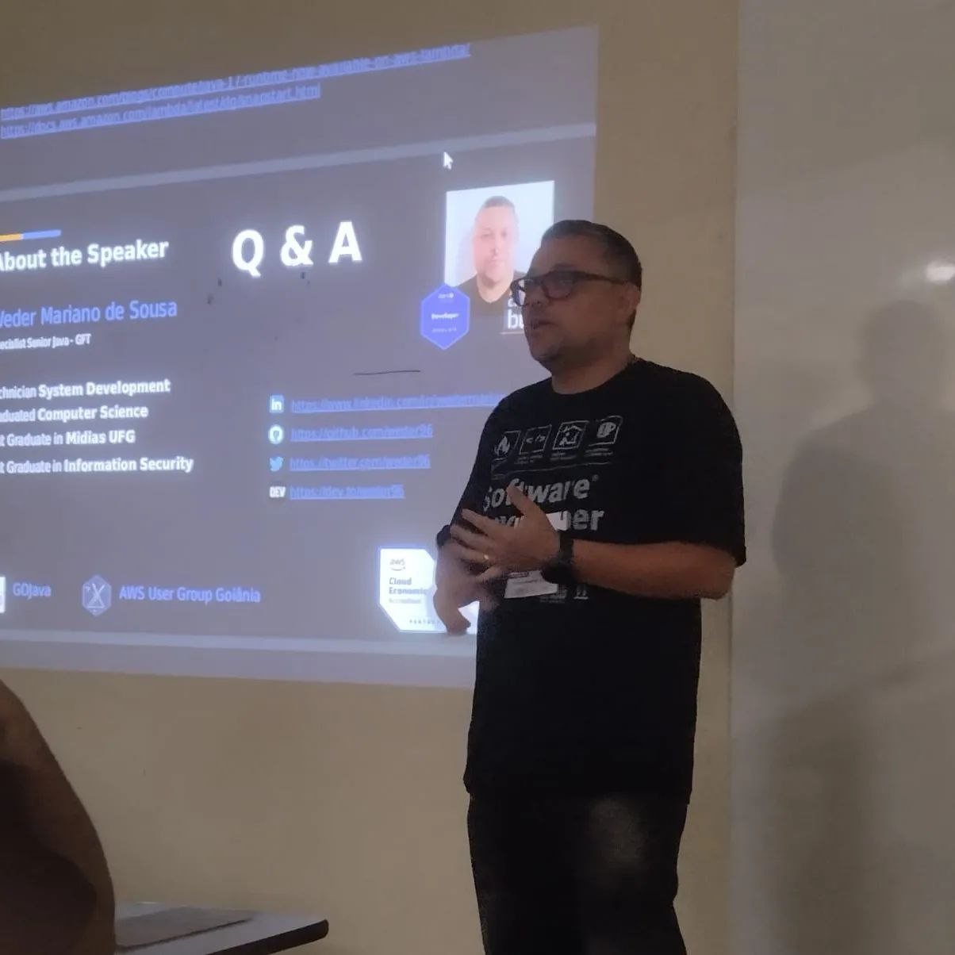

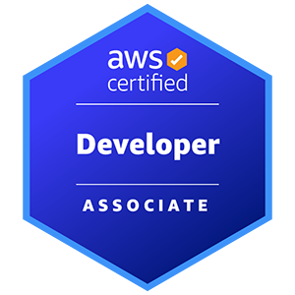
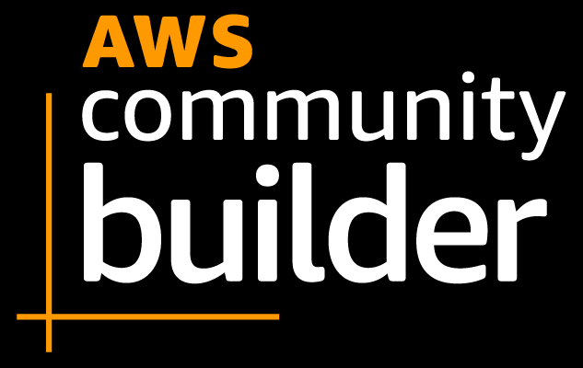
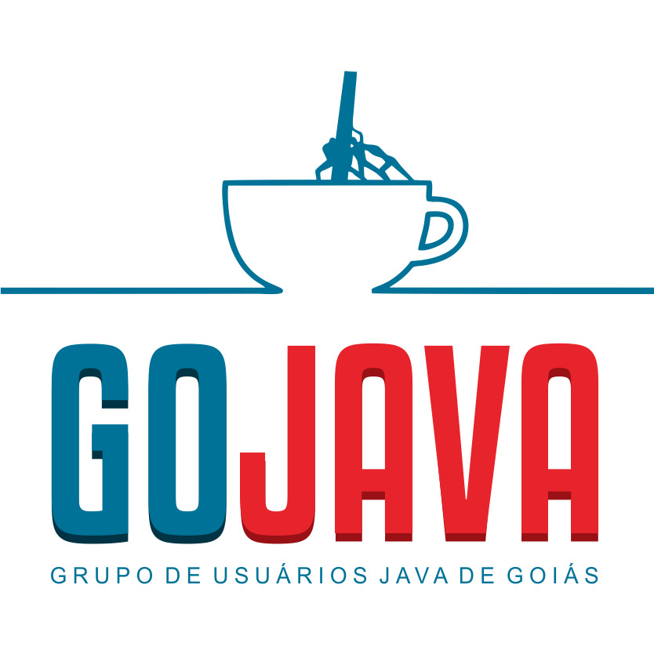
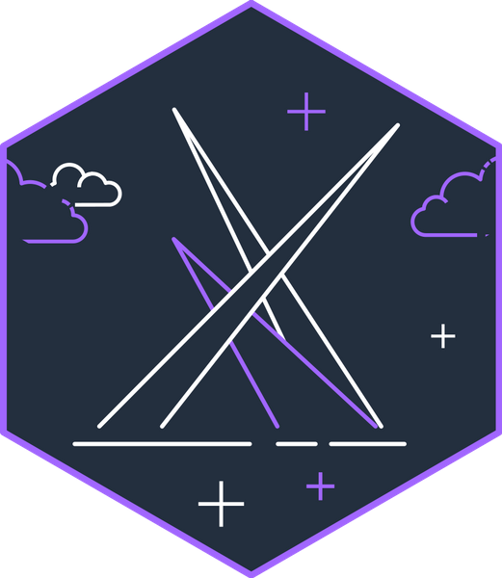
Me
Weder Mariano de Sousa
Specialist Senior Java - GFT
GOJava
AWS User Group Goiânia
Notes:
I work in the area of ​​computing since the year 2000.
I am currently a graduate in Computer Science, I have two specializations in Information Security (UniLeya) and the other in Intermediate Media (UFG). Prior to my graduation, I graduated from Cepa (Centro de Estudos Profissionalizantes de Anápolis) Developing Systems and attending FreeCodeCamp to evolve knowledge.
I worked in this time with several technologies among them,
Java
Spring Framework (dependency injection, Spring Data, Spring Security, Spring boot)
WebService (Rest / Soap)
Hibernate
HTML 5
Javascript, NodeJs
CSS, CSS3
Bootstrap
JSP
JSF (Primefaces)
AngularJS, React, React Native and VueJS
Database (Oracle, SqlServer, Postgres, MySQL and DB2)
Non-Relational Database (MongoDb, Neo4J)
Junit
Selenium
I am a computer teacher and Free Software enthusiast.
I helped coordinate FLISOL 2013,2014,2015 and 2016 in Anápolis-Goiás. Participate actively in the Free Software movement in Goiás, a member of the Anapolivre community, I am currently a Developer Analyst at Grupo GFT, where I work with Java and Angular projects, where I have been working since 2018.
I helped coordinate FLISOL 2013,2014
I helped coordinate JoinCommunity 2022, 2023
Grupo GFT
Java, Spring Boot, JPA, RestTemplate, WebClient, Reactive Programming, Functional Programming, Rest Assured, Mockito, Unit Testing, Cumcuber, Kafka, RabbitMQ, ActiveMQ, Azure Services, AWS Services

Slide 3

Agenda
Question Artificial intelligence
Use Case
Requirement and Tools
Introduction About Serverless
Architecture Serverless
AWS CDK For Java and Python
Next Steps
Notes:
Thanks for your time
let's go

Slide 4



Question Artificial intelligence
Create a study routine focused on learning Serverless AWS?
Notes:
I wanted to ask a question to Chat GPT (OpenAI) and Bard (Google), and upon receiving the answer, I thought, if I follow these steps that were suggested to me I could understand better about AWS Serverless.
Yes, this presentation in tutorial mode was born from this question.

Slide 5

ChatGPT
Ongoing
Join AWS forums and communities.
Follow AWS blogs and attend webinars.
Keep experimenting with new AWS services and features.
Stay updated with AWS documentation and best practices.
Week 1-2: Fundamentals and AWS Basics
Week 3-4: AWS Lambda
Week 5: AWS API Gateway
Week 6: AWS Step Functions
Week 7-8: Serverless Application Development
Week 9-10: Advanced Topics and Best Practices
Remember to adapt this study routine to your pace and
background knowledge.
Regular practice and hands-on experience are key to
becoming proficient in Serverless AWS.
Week 11-12: Real-world Projects and Certifications
Notes:
Both chatGPT and bard answered something similar, some small differences, but the same model
divided the content to be learned into weeks and at the end a message that leads the user to have something like discipline, talk to people with more knowledge on the subject and try, try and try

Slide 6

Bard
Find a study group. Work with other people
can help you learn and solve problems.
Don't be afraid to ask for help. If you get stuck on a concept,
Don't be afraid to seek help from your instructor, a friend or
of an online discussion group.
Week 1-2: Introduction to Serverless AWS
Week 3-4: AWS Cognito, AWS CloudWatch AWS CloudFormation
Week 5-6: Advances in Serverless AWS Serverless AWS Use Cases Serverless Projects
Personal Projects: Building Serverless AWS Applications Resources
Self-study: Reading documentation
AWS Documentation AWS Tutorials
This routine can be adapted according to needs and
student goals.
For example, students with experience developing
software can advance content more quickly.
Students with less experience can dedicate more time to
study of basic concepts.
Set realistic goals. Don't try to learn everything at once.
Start with the basics and progress gradually.
Create a schedule and stick to it. Having a plan will help you
keep motivated and on tr

Slide 7

Use Case
CRUD - Register Items
using AWS Serverless
Don't worry
about infrastructure
Notes:
When I think about the question about creating a regular, then I thought about creating something,
I started studying, step by step, AWS serverless technologies, one after another,
I got to know AWS CDK,
I come from a world where we only code, there were professionals with the knowledge about DevOps (Culture), however, we are currently the center of all tasks, from requirements analysis, such as unit testing and also in application observability issues, our activities have increased proportionally to the challenges of a new world of development using cloud computing
In this use case, we will work on creating an application that can save, change, search and delete an item, such as an item register, widely used in e-commerce, such as:
Alibaba (China) US$ 1,249 tri
Amazon (United States) US$602 billion
JD.com (China) US$505 billion
Pinduoduo (China) US$383 billion
eBay (United States) US$85 billion
Walmart (United States) US$ 73.2 billion
Shopee (Singapore) US$62.6 billion
Rakuten (China) US$ 32.8 billion
Mercado Libre (Argentina) US$ 28.4 billion
Vipshop (China) US$ 26 billion

Slide 8
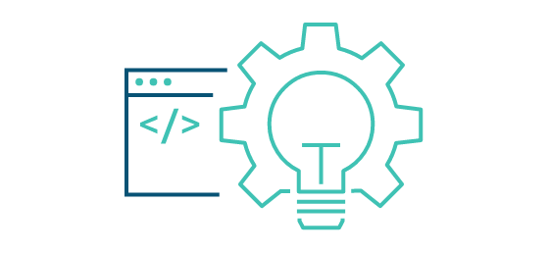

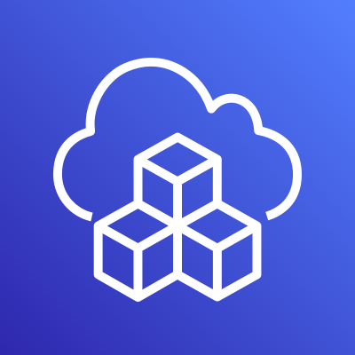

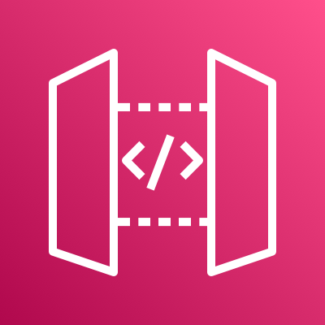


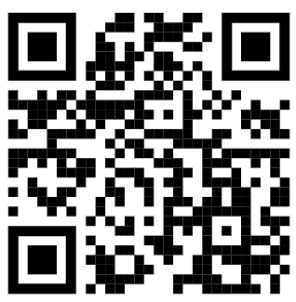
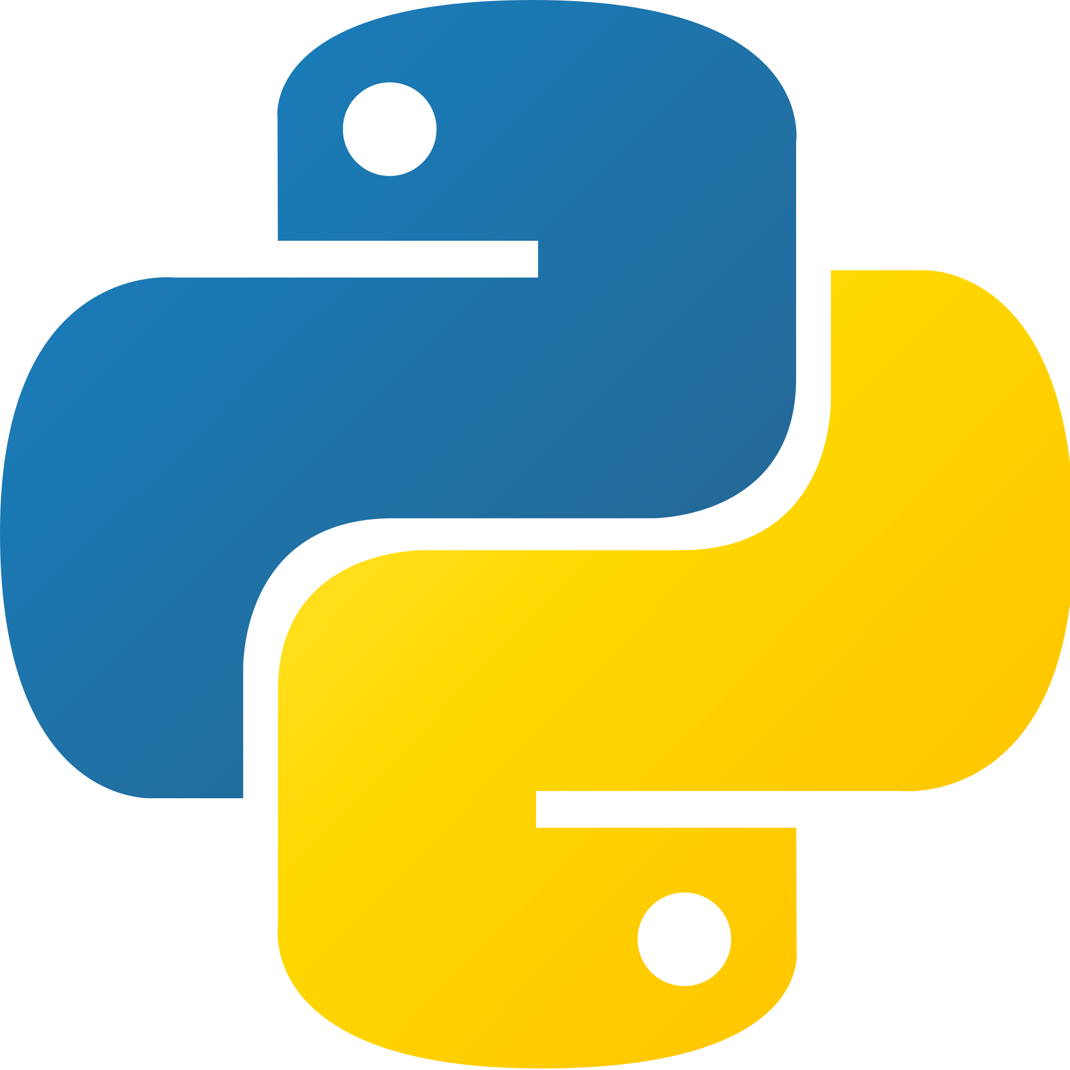




Use Case AWS CDK - CRUD
AWS Cloud
create
sdk(Boto3)
Users
POST
API Gateway
EndPoint
Lambda
function
Amazon
API Gateway
update
sdk(Boto3)
PATCH
API Gateway
EndPoint
Lambda
function
get All
sdk(Boto3)
GET
API Gateway
EndPoint
Lambda
function
DynamoDB
Table
(orders)
get By Id
sdk(Boto3)
GET
API Gateway
EndPoint
Lambda
function
delete
sdk(Boto3)
Stack
DELETE
API Gateway
EndPoint
Lambda
function
AWS CloudFormation
Amazon CloudWatch
https://github.com/weder96/poc-cdk-java
Notes:
In this use case, we focus on creating API using the HTTP protocol, for this service we will use API Gateway in Rest API mode
We will create 5 endpoints (Create, Update, getOne, getAll, Delete), using methods (Post, Patch, Get, Get, Delete) respectively.
each endpoint is connected to a lambda function, using the Python programming language in its version 3.10 in its code
Lambda functions coded in Python will use Boto3, the AWS SDK for communication and manipulation of data or events between AWS services.
Something to clarify here at this point is the difference between CDK and SDK, CDK is used to create AWS services, but behind the same being used is the SDK to create all these services.
This is important because boto3 uses the SDK to communicate between services.
All services in this use case will be created using CDK in Java(11).
You can point the qrcode reader and see the repository on github (weder96), or follow the link below, where you will find all the codes that we will use in this use case

Slide 9

Requirement and Tools

Slide 10
Requirement and Tools
AWS Account and User
AWS CLI
Python 3.10
IDE for your programming language = Visual Studio Code
IDE for your programming language = Intellij IDE
Postman
Notes:
1. It is necessary to create an account on AWS, when creating it they will ask for a credit card number, but only for validation and additional usage charges, however when creating your account you will be starting your free tier, in our case all the services that we will use for create our use case, there is no additional cost.
2. CLI it is necessary to configure your accesskey and secretKey to use the command execution feature that creates services in AWS without the need for manual creation via the console, just use the console to validate that it was created as specified
3. This is optional, as it can be tested directly with lambda functions, but it's nice to have some knowledge of programming in Python
4. This is optional Visual Studio Code is a source code editor developed by Microsoft for Windows, Linux, and macOS. It includes support for debugging, built-in Git versioning, syntax highlighting, smart code completion, snippets, and code refactoring. release 2015
5. This is optional IntelliJ IDEA is an integrated development environment written in Java for developing computer software written in Java, Kotlin, Groovy, and other JVM-based languages. release 2001, you can use the community version
6. This is optional Postman is an API platform for developers. The company is locate in San Francisco and maintains an office in Bangalore, where it was founded. As of February 2023, Postman reports having more than 25 million registered users and 75,000 open APIs, which it says constitutes the world's largest public API hub.
We will use postman to make http calls on our created endpoint
Note: items listed as optional can be exchanged for others that have the same purpose

Slide 11
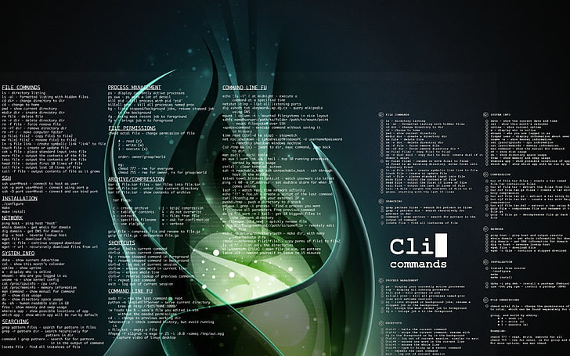

Install AWS Command Line Interface (AWS CLI) Linux

Slide 12
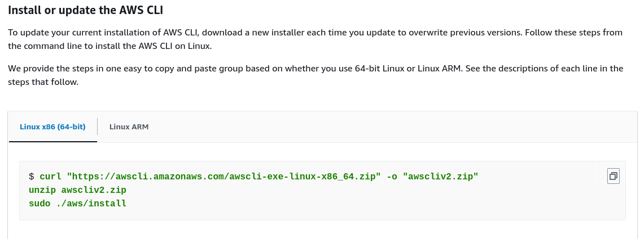
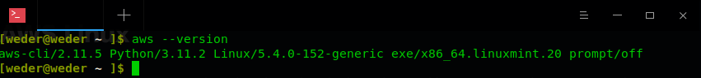
Install AWS Linux
You must be able to extract or "unzip" the downloaded package. if your operating system doesn't have the built-in unzip command, use an equivalent.
The AWS CLI uses glibc, groff, and less. These are included by default in most major distributions of Linux.
We support the AWS CLI on 64-bit versions of recent distributions of CentOS, Fedora, Ubuntu, Amazon Linux 1, Amazon Linux 2 and Linux ARM.
Because AWS doesn't maintain third-party repositories.
We can’t guarantee that they
contain the latest version of the AWS CLI.
https://docs.aws.amazon.com/cli/latest/userguide/getting-started-install.html
Notes:
You can install aws-cli on several distributions, however it is better to install directly from the AWS repository, because you cannot guarantee that the latest version when installed by third-party repositories
This example(slide presentation) we are installing aws-cli on a 64 bit (Linux Mint 21.2 "Victoria"), using curl command , then unzipping and running the installation command,

Slide 13

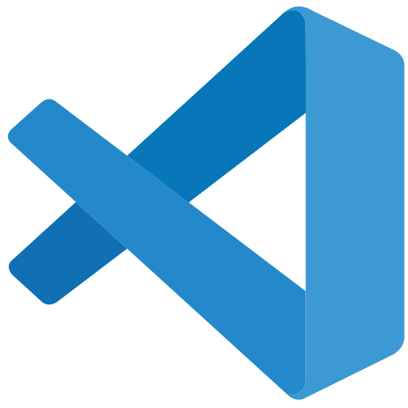

AWS IDE Toolkits

Slide 14
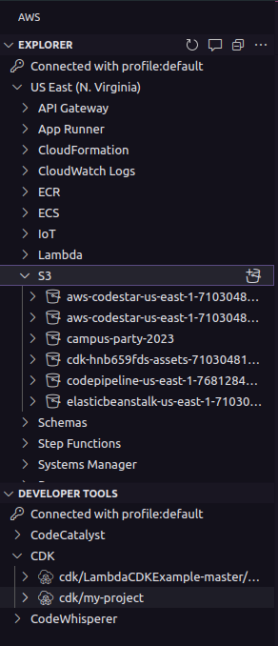
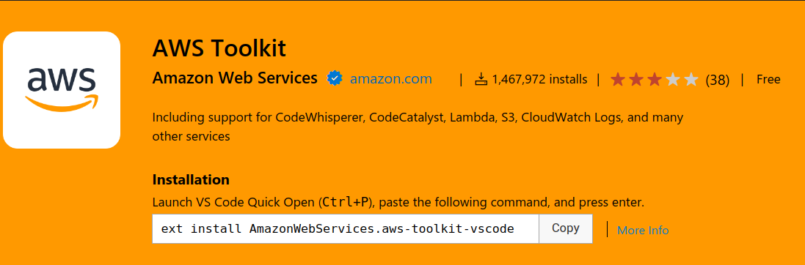
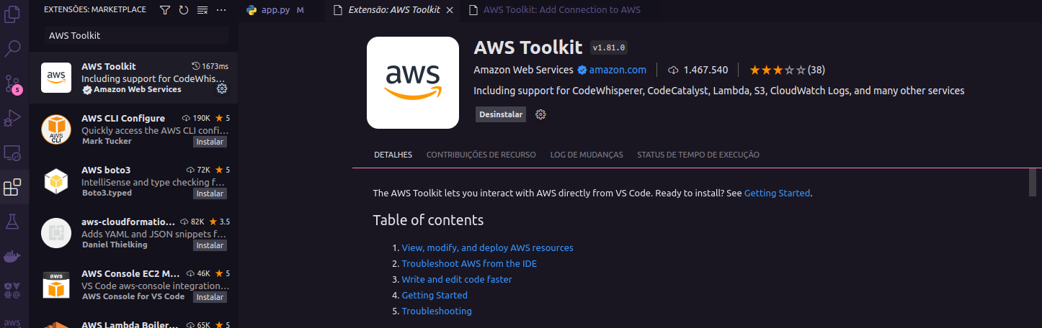
AWS Toolkit for Visual Studio Code
https://aws.amazon.com/serverless/?nc1=h_ls
https://marketplace.visualstudio.com/items?itemName=AmazonWebServices.aws-toolkit-vscode
Notes:
There is an AWS extension that can be installed in vscode, it shows you which services were created, being the same useful, helping in many cases

Slide 15
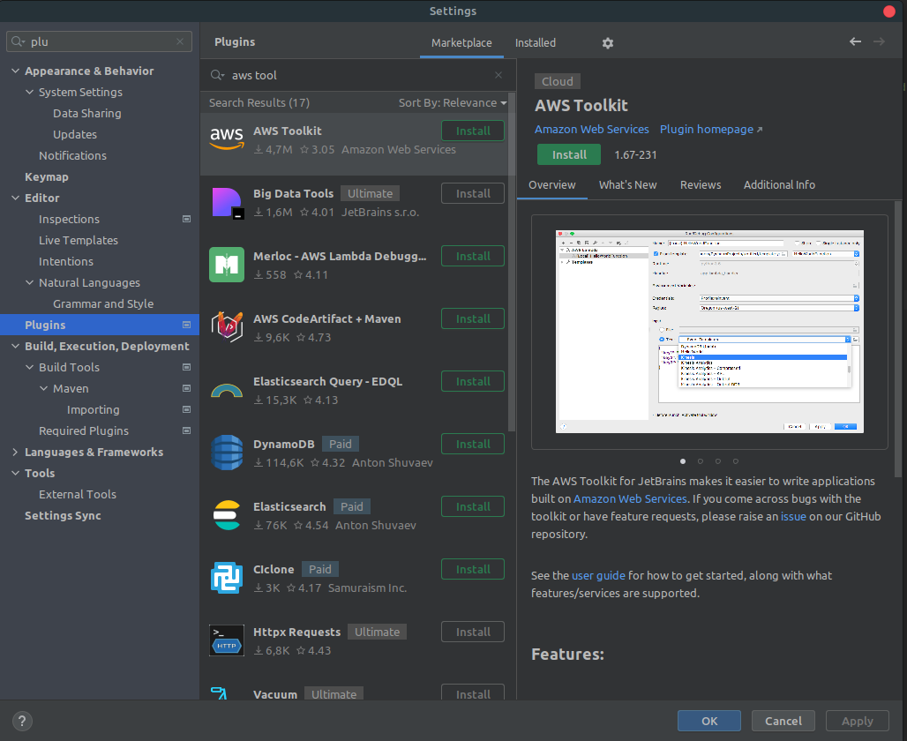
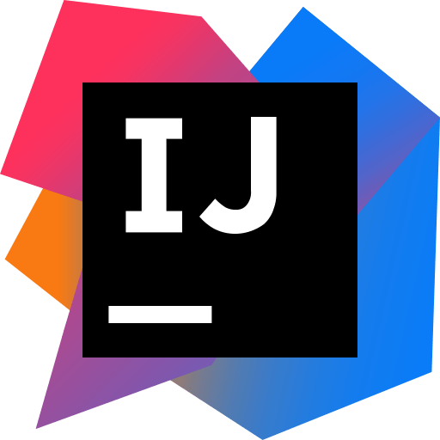
What is Toolkits IDE AWS ?

Slide 16
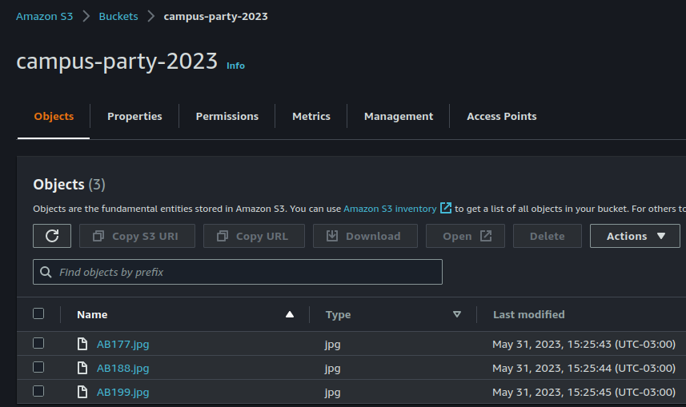
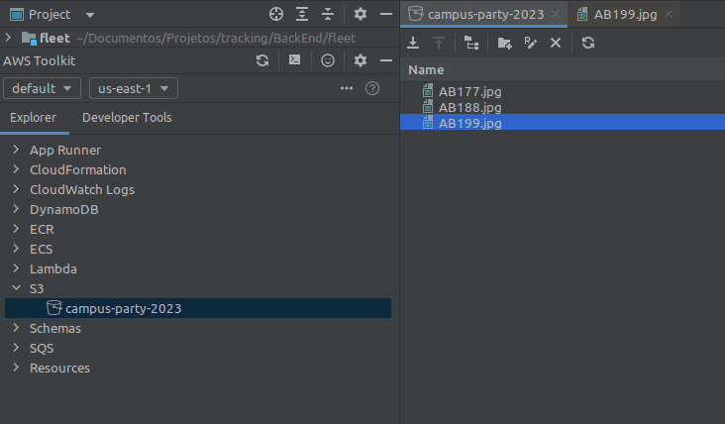
What is Toolkits IDE AWS ?

Slide 17

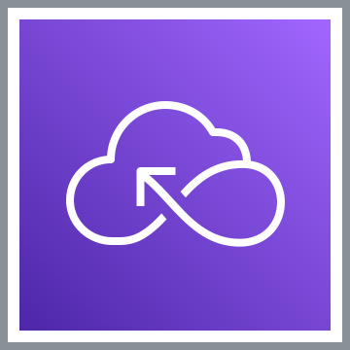
Introduction AWS Serverless

Slide 18
What is “Serverless” ?
It’s not about having servers or the lack of servers
https://da-public-assets.s3.amazonaws.com/serverlessland/pdf/SVS401-ri22.pdf

Slide 19
What is “Serverless” ?
Consider “serverless” as:
A mindset, an approach, a practice, a culture, a way of working Focus on business value, rather than the enabling technology
Benefits:
Faster time to market from prototype to production
Rapid, continuous experimentation and feedback
React and deliver business changes with a product mindset
Serverless = the best way to build and run modern applications
“Serverless” architecture is an operational model
Minimize taking on ongoing operational tasks, outsource system administration tasks
Every non-serverless component = ongoing ops responsibility
Optimize for long-term maintainability
Serverless does not mean "No Ops“!
Concentrate on the flow of data and events
https://da-public-assets.s3.amazonaws.com/serverlessland/pdf/SVS401-ri22.pdf

Slide 20
Events are the language of
serverless applications.
Dave Boyne
AWS Serverless Developer Advocate
https://da-public-assets.s3.amazonaws.com/serverlessland/pdf/SVS401-ri22.pdf

Slide 21
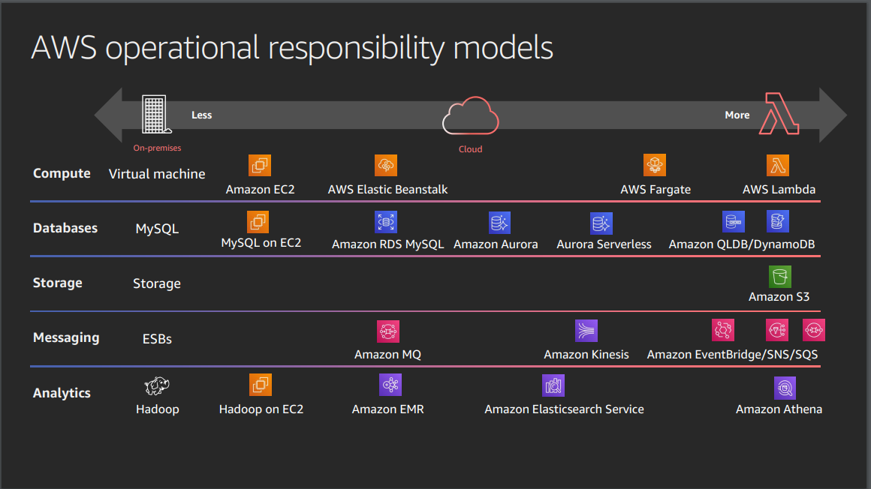
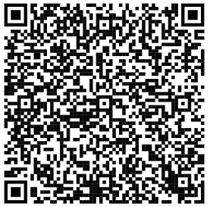
Serverless Explanained : AWS Operational Responsibility Model
https://d1.awsstatic.com/events/reinvent/2019/REPEAT_3_Serverless_architectural_patterns_and_best_practices_ARC307-R3.pdf

Slide 22
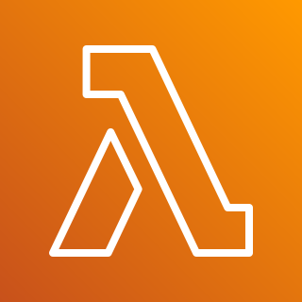
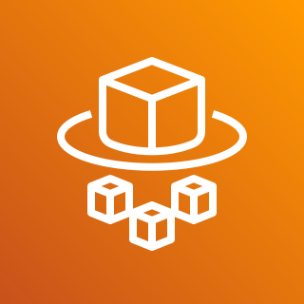

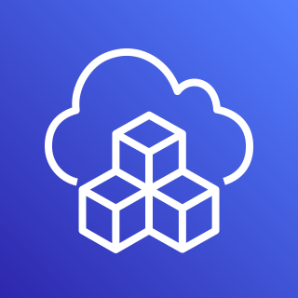


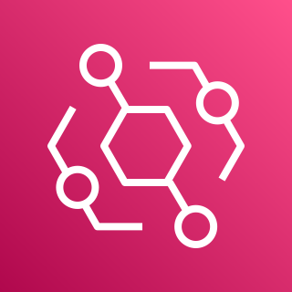
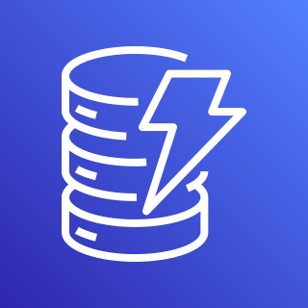
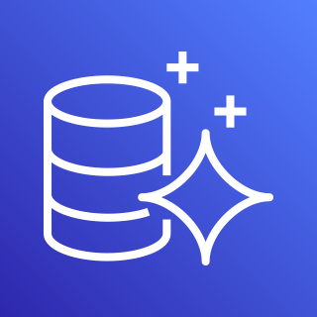
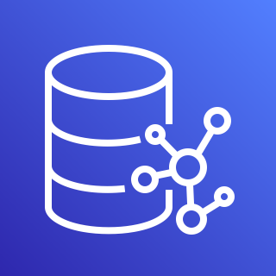
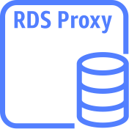
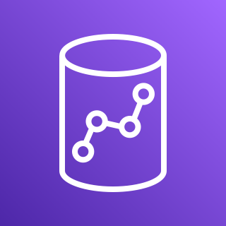

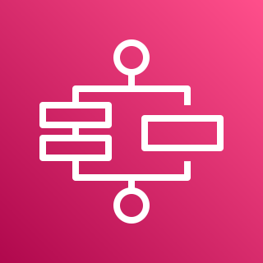


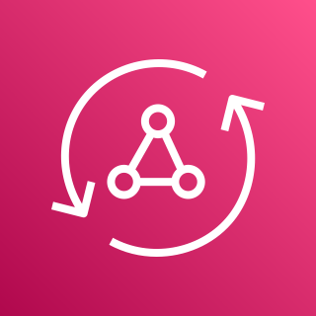

AWS Services Serverless
Application Integrations Services
Compute
Serverless Deployment
Frameworks
4
1
Authentication
and Authorization
3
2
AWS Lambda
AWS Fargate
Amazon Cognito
AWS CloudFormation
AWS CDK
Amazon
SNS
Amazon
SQS
Amazon
EventBridge
Data Persistence
5
Research and Analysis
6
Application Orchestration
7
DynamoDB
Aurora
Serverless
Neptune
Serverless
RDS
proxy instance
Amazon Redshift
OpenSearch
Service
AWS
Step Functions
Storing & Hosting
8
Streams
API and AppSync
9
10
Amazon S3
Amazon EFS
DynamoDB
Stream
Kinesis Data Streams
Amazon
API Gateway
AWS
AppSync
https://aws.amazon.com/serverless/?nc1=h_ls

Slide 23
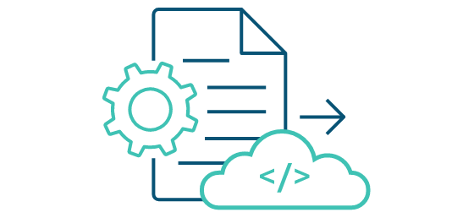


How to build, run and deploy?
When starting designing, and building serverless function, you might wonder how to deploy your function into the cloud. With AWS, there are some ways we can deploy, test and invoke your function:
Using the AWS Console Management: we can create lambda function, upload code, add triggers, and test your Lambda function manually. You might use this way when first.
AWS CLI: you also can use AWS Lambda CLI to create, deploy, invoke, manage, monitor your Lambda function. You can use existing commands to deploy and test your Lambda function automatically without manual process. But this isn’t good for production and large project.
AWS Serverless Application Model (AWS SAM) is an open-source framework for building serverless applications. It provides shorthand syntax to express functions, APIs, databases, and event source mappings.
AWS Cloud Development Kit (AWS CDK) is an open source software development framework to define your cloud application resources using familiar programming languages.
https://aws.amazon.com/serverless/getting-started/?nc=sn&loc=2&serverless.sort-by=item.additionalFields.createdDate&serverless.sort-order=desc

Slide 24
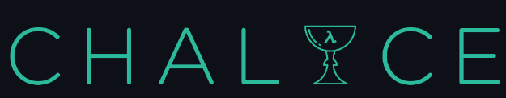

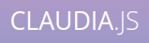
How to build, run and deploy?
Serverless Framework - The Serverless Framework consists of an open source CLI and a hosted dashboard. Together, they provide you with full serverless application lifecycle management.
Chalice is a framework for writing serverless apps in Python. It allows you to quickly create and deploy applications that use AWS Lambda.
Arc.codes provides everything you need to build massively scalable serverless apps with low code, clear and terse config, and zero ceremony.
Claudia.js makes it easy to deploy Node.js projects to AWS Lambda and API Gateway.
https://aws.amazon.com/serverless/getting-started/?nc=sn&loc=2&serverless.sort-by=item.additionalFields.createdDate&serverless.sort-order=desc

Slide 25
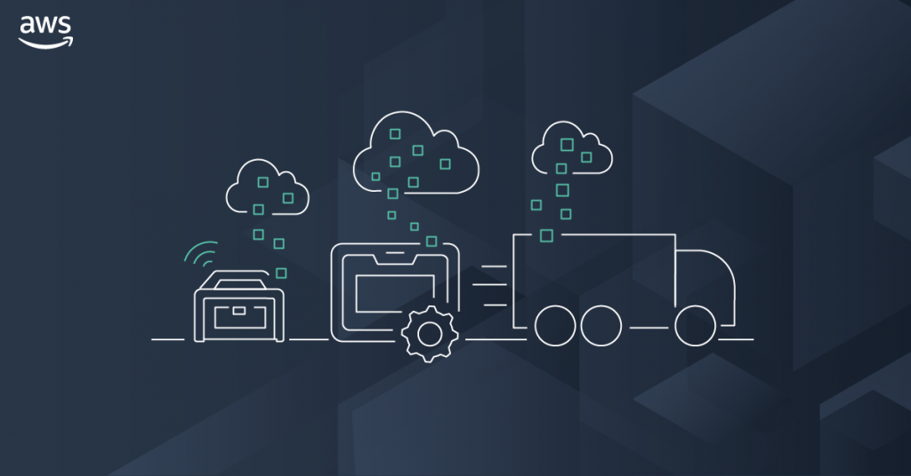
AWS Storage

Slide 26
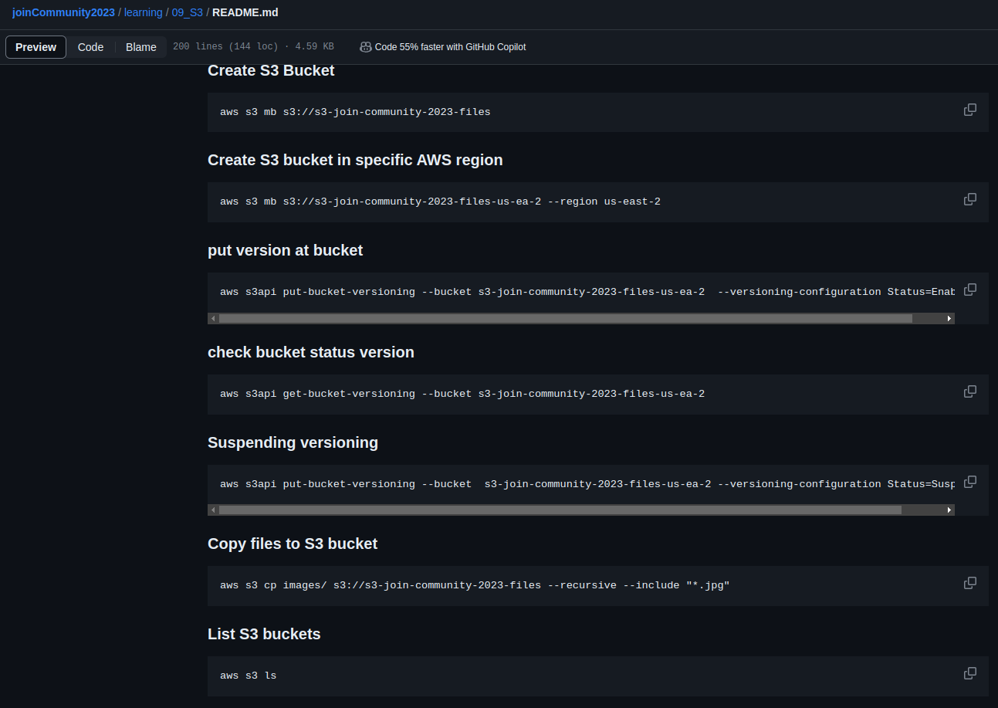
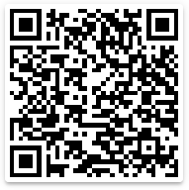
Amazon S3 CLI Commands
Amazon S3
Figure: 1 - describe using CLI Commands handling Objects in S3 service.
https://github.com/weder96/joinCommunity2023/blob/main/learning/09_S3/README.md

Slide 27
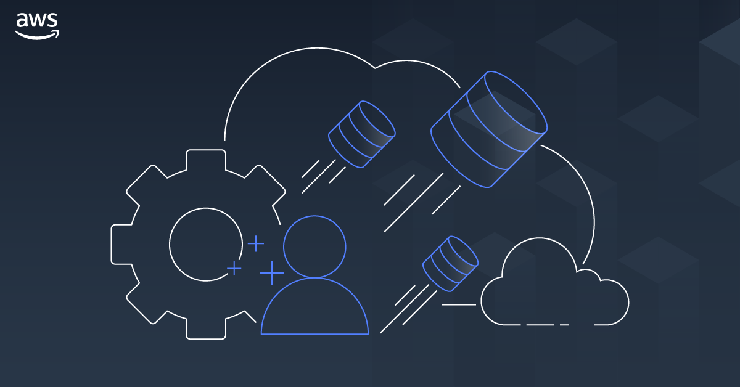
AWS Database
DynamoDB
Aurora
Neptune

Slide 28
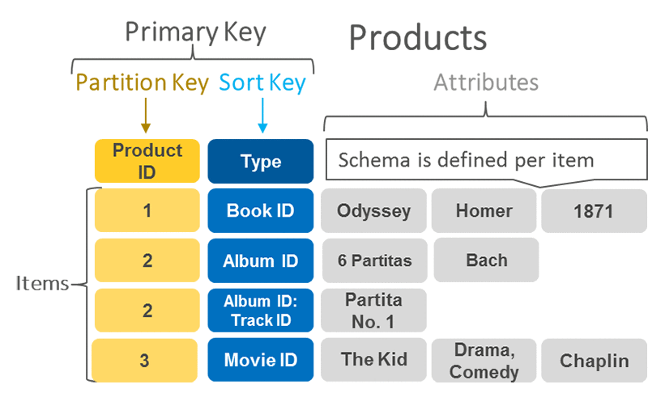
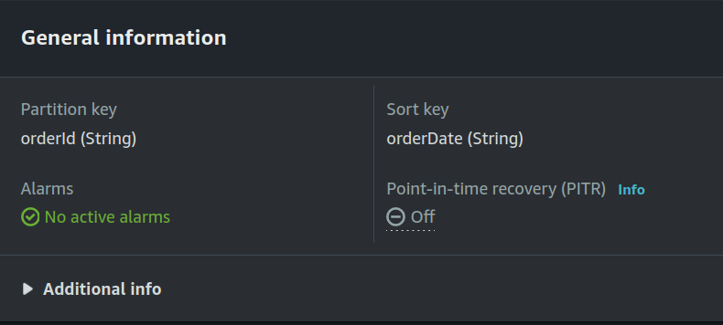
DynamoDB Primary Key, Partition Key and Sort Key
A primary key uniquely identifies each item in the table, so no
two items can have the same key. DynamoDB supports two
different kinds of primary keys:
Partition key
Partition key and sort key
Partition key
A simple primary key, composed of one attribute known as the
partition key.
Partition key and Sort Key
It is Referred to as a composite primary key, this type of key is
composed of two attributes. The first attribute is the partition
key, and the second attribute is the sort key.
DynamoDB uses the partition key value as input to an internal
hash function. A composite primary key gives you additional
flexibility when querying data
Figure: 1 - Partition Key and Sort Key (Primary key)
Figure: 2 - Details table (Partition Key, Sort Key)
https://aws.amazon.com/blogs/database/choosing-the-right-dynamodb-partition-key/

Slide 29
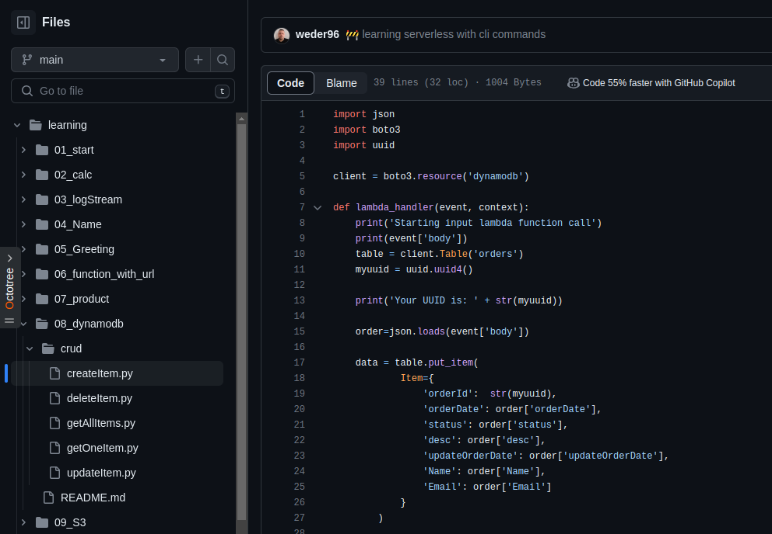
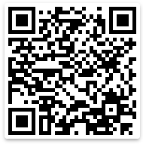
DynamoDB Python(Boto3)
DynamoDB
Figure: 1 - Function Lambda (using Python 3.10), CRUD DynamoDB
https://github.com/weder96/joinCommunity2023/tree/main/learning/08_dynamodb

Slide 30
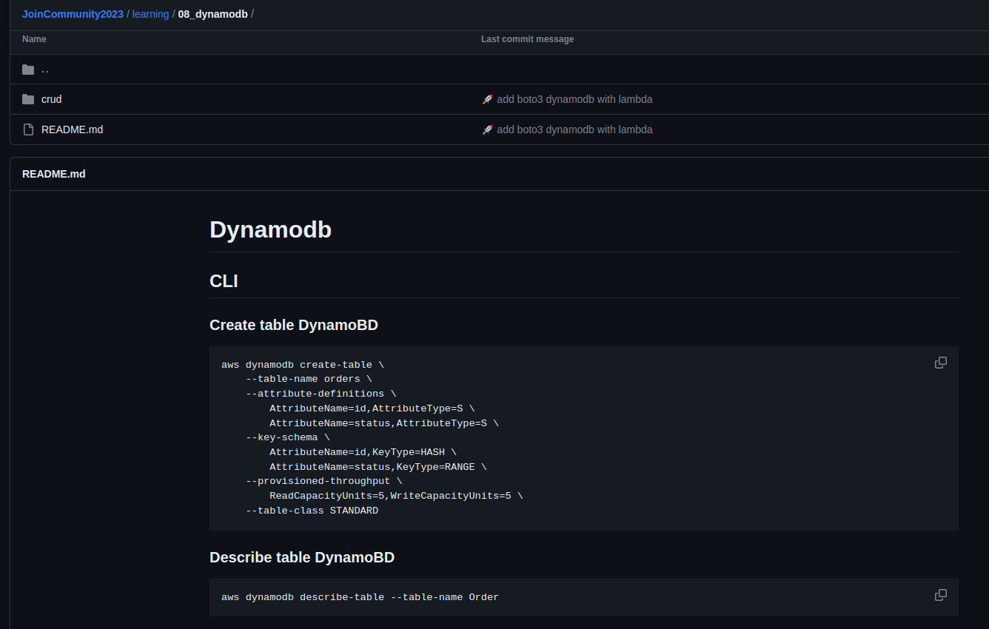
DynamoDB CLI Commands
DynamoDB
Figure: 1 - create table AWS CLI Commands
https://github.com/weder96/joinCommunity2023/tree/main/learning/08_dynamodb

Slide 31
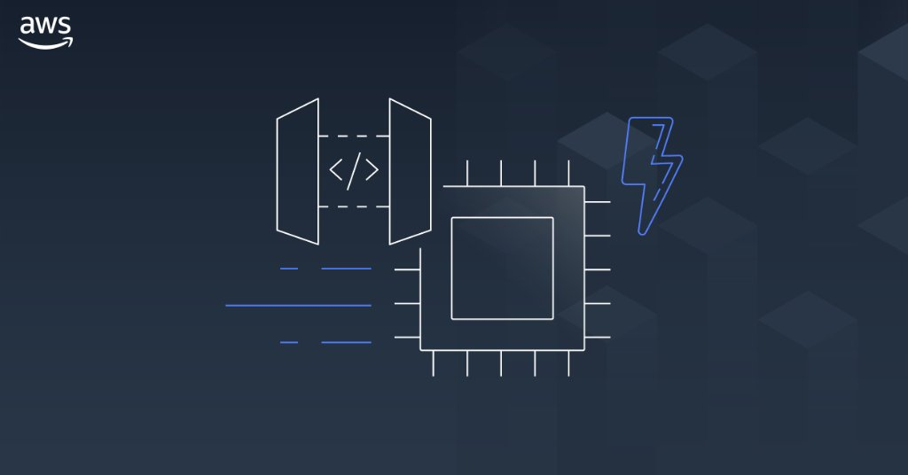
AWS API Gateway

Slide 32
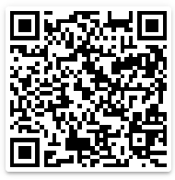
Amazon API Gateway Concepts
API Deployment – a point-in-time snapshot of your API Gateway API resources and methods. To be available for clients to use, the deployment must be associated with one or more API stages.
API endpoints – host names APIs in API Gateway, which are deployed to a specific region and of the format: rest-api-id.execute-api.region.amazonaws.com
API key – An alphanumeric string that API Gateway uses to identify an app developer who uses your API.
API stage – A logical reference to a lifecycle state of your API. API stages are identified by API ID and stage name.
Model – Data schema specifying the data structure of a request or response payload.
Private API – An API that is exposed through interface VPC endpoints and isolated from the public internet
Private integration – An API Gateway integration type for a client to access resources inside a customer’s VPC through a private API endpoint without exposing the resources to the public internet.
Proxy integration – You can set up a proxy integration as an HTTP proxy integration type or a Lambda proxy integration type.
Usage plan – Provides selected API clients with access to one or more deployed APIs. You can use a usage plan to configure throttling and quota limits, which are enforced on individual client API keys.
Amazon
API Gateway
https://github.com/weder96/aws-certification-learning/tree/main/module-5#section-10

Slide 33
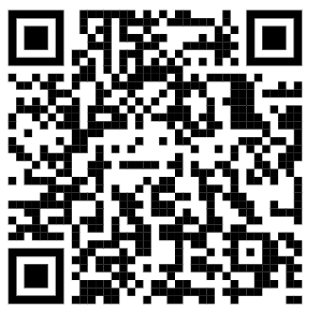

Amazon API Gateway CLI Commands
Amazon
API Gateway
Figure: 1 - create API Gateway AWS CLI Commands (Role, Lambda, Resources, Permissions, putMethodResponse)
https://github.com/weder96/joinCommunity2023/tree/main/learning/10_ApiGateway

Slide 34


AWS Application Integration
SNS
SQS
EVENTBRIDGE

Slide 35

Amazon SNS

Slide 36



Amazon SNS: Fully Managed Pub/Sub Messaging
Application
Integration
Application integration
The Fanout scenario is when a message published to an SNS topic is replicated and pushed to multiple endpoints.
Application alerts
Amazon SNS can send notifications to specified users via SMS and email.
User notifications
Amazon SNS can send push email messages and text messages to individuals or groups.
Mobile push notifications
Mobile push notifications enable you to send
messages directly to mobile apps.
Amazon SNS
Amazon SQS
AWS Lambda
EventType=
Poll-based
Queue
Lambda Function
Messages
1,2,3,....
Topic
EventType=
Poll-based
Queue
Lambda Function

Slide 37


Amazon SNS CLI Commands and (Python) Boto3
Amazon SNS
Figure: 1 - create SNS AWS CLI Commands (Lambda, topic , subscribe , permission)
https://github.com/weder96/joinCommunity2023/blob/main/learning/15_lambda_sns/README.md

Slide 38

Amazon SQS

Slide 39
What is Amazon SQS ?
Application
Integration
Amazon SQS stands for Simple Queue Service is fully managed message queues for microservices,
distributed systems, and serverless applications.
Enables you to decouple and scale microservices, distributed systems, and serverless applications.
Eliminates the complexity and overhead associated with managing and operating message-oriented
middleware.
Send, store, and receive messages between software components at any volume.
Two types of message queues.
Standard queues offer maximum throughput, best-effort ordering, and at-least-once delivery.
FIFO queues are designed to guarantee that messages are processed exactly once, in the exact order that they are sent.
Integrate and decouple distributed software systems and components.
Provides a generic web services API that you can access using any programming language that the AWS
SDK supports.
Amazon SQS
https://aws.amazon.com/sns/?nc1=h_ls

Slide 40
Amazon SQS What’s a queue?
Application
Integration
Send MEssages
Pool messages
Producer
consumer
Producer
consumer
Queue
consumer
Producer
consumer
Amazon SQS
https://aws.amazon.com/sns/?nc1=h_ls

Slide 41


Amazon SQS CLI Commands and (Python) Boto3
Application
Integration
Amazon SQS
Figure: 1 - create SQS AWS CLI Commands (create, poll , send messages , permission, purge)
https://github.com/weder96/joinCommunity2023/blob/main/learning/16_lambda_sqs/README.md

Slide 42

Amazon EventBridge

Slide 43

What is Amazon EventBridge ?
Serverless event bus service for AWS services
Build event-driven applications at scale using events generated from your apps
Use to connect your applications with data from a variety of sources, integrated SaaS applications
AWS services to targets such as AWS Lambda functions
Formerly called Amazon CloudWatch Events
https://serverlessland.com/patterns
https://da-public-assets.s3.amazonaws.com/serverlessland/pdf/2021+-+Serverlesspresso+exhibit+-+PDF.pdf

Slide 44

What are events?
An event is defined in JSON
"Detail" is application specific
Envelope attributes are provided by
Amazon EventBridge
Producers create events
Consumers choose which events to
Listen to by using rules
Figure: 1 - JSON event details is Custom(You define)
https://da-public-assets.s3.amazonaws.com/serverlessland/pdf/2021+-+Serverlesspresso+exhibit+-+PDF.pdf

Slide 45


Understanding EventBridge target
Does not know about
consumers decoupled
Bus need permissions
to talk to targewt(ex lambda)
Eventbus
rule
target
filter out events
Eventbus
rule
Also knoe as
consumer
Target Example
Lambda
What are target ?
Targets are consumer of you events
use rules to process events before reaching targets
Target Permissions
Your eventBridge bus need permissions
to send events to targets
Serverless Visuals: Small bite sized visuals about Amazon EventBridge David Boyne

Slide 46


Amazon EventBridge CLI Commands and (Python) Boto3
Amazon EventBridge
Figure: 1 - create EventBridge AWS CLI Commands (create, putTarget, putRule , permission, putEvents)
https://github.com/weder96/joinCommunity2023/blob/main/learning/19_eventbridge/README.md

Slide 47

AWS Application Orchestration
STEP FUNCTIONS

Slide 48

AWS Step Functions

Slide 49












State types
Task
A single unit of work
Choice
Adds branching logic
Parallel
Fork and join the data across tasks
Wait
Delay for a specified time
Fail
Stops an execution and marks it as a failure
Succeed
Stops an execution successfully
Pass
Passes its input to its output
Map
Loop and Foreach

Slide 50


Create a Serverless Workflow with AWS Step Functions and AWS Lambda
Figure: 1 - StepFunctions Studio(create, view, execute the state Machine )
https://aws.amazon.com/pt/tutorials/create-a-serverless-workflow-step-functions-lambda/

Slide 51


Amazon Step Functions CLI Commands and (Python) Boto3
Figure: 1 - StepFunctions CLI Commands(create, update, execute the state Machine) and create lambda
AWS Step Functions
https://github.com/weder96/joinCommunity2023/blob/main/learning/21_step_function/README.md

Slide 52

AWS Lambda Overview

Slide 53
AWS Lambda Overview
Serverless on AWS, Build and run applications without thinking about servers
The most popular serverless compute platform that is using millions of customer
Running billions of invocations all over the world
Compute service that runs code without thinking any servers or underlying services
Serverless function that you only responsible for your actual code.
https://aws.amazon.com/serverless/?nc1=h_ls
https://aws.amazon.com/blogs/compute/serverless-icymi-q2-2023/

Slide 54


AWS Lambda Invocation Types
Triggered lambda functions with different AWS Lambda Invocation Types
AWS Lambda has 3 Invocation Types;
Lambda Synchronous invocation
Lambda Asynchronous invocation
Lambda Event Source Mapping with polling invocation
https://aws.amazon.com/blogs/architecture/understanding-the-different-ways-to-invoke-lambda-functions/

Slide 55

Lambda Function Code
AWS Lambda runs instances of your function to process
events.
Invoke function directly using the Lambda API, or
configure an AWS service or resource to invoke your function.
Lambda function has code to process the events
that you pass into the function or that other AWS
services send to the function with event json object.
The event object contains all the information about
the event that triggered this Lambda.
The context object contains info about the runtime
our Lambda function
Return the function with the results

Slide 56



AWS Lambda Execution Role
Resource Based
Policy
Execute Role
Policy
AWS Lambda Permissions
Lambda Execution Role
Resource-based policy
Lambda Execution Role
IAM role that Lambda has permissions to assume when invoking
lambda function.
Create an execution role when creating a new lambda function, and
after that we can also modify the policies associated with the IAM role.
if you have additional targets from your lambda function
performing crud operations on DynamoDB table
sending notification to SNS
retrieve messages from queue or streams
Lambda function's execution role required permissions to
interact with those AWS services
Grant least privilege access to your Lambda execution role
Who can Invoke
Lambda ?
Who can interact
Lambda Invoke ?
AWS Lambda
Figure: 1 - Policy(JSON), set Permissions for execute lambda or
lambda invoke AWS Services
https://docs.aws.amazon.com/lambda/latest/dg/lambda-intro-execution-role.html

Slide 57
AWS Lambda Resource-based Policy
Lambda Resource-based policy
When any AWS service invokes Lambda function sync or async way. It lets you grant usage permission to other AWS accounts or organizations on a per-resource basis. Also use a resource-based policy to allow an AWS service to invoke your function on your behalf.
API Gateway that targets to Lambda function, we should add resource-based policy permission to invoke
lambda function from API gateway.
Amazon S3 upload event triggers to lambda function asyncrhously, so we should also add Resource-based policy into our Lambda function grants S3 invocation.
Resource Based
Policy
Execute Role
Policy
Amazon SNS
DynamoDB
Amazon
API Gateway
allow
sns.amazon.com
Lambda:
InvokeFunction
allow
Dynamodb: PutItem
logs: PutLogs
AWS Lambda
Amazon CloudWatch
Amazon S3
https://docs.aws.amazon.com/lambda/latest/dg/lambda-intro-execution-role.html

Slide 58

Architecture
Serverless
Notes:
we reached a different level

Slide 59
Amazon SNS with AWS Management Console
AWS Cloud
Command CLI
Create
User
topic
Topic
AWS Command Line Interface (AWS CLI)
Amazon Simple Notification Service (Amazon SNS)

Slide 60
Amazon SQS Queue Polling From AWS Lambda
AWS Cloud
Send /Messages
EventType =
Poll-based
User
Queue
Lambda
function
Amazon Simple Queue Service (Amazon SQS)
Event Filter
AWS Lambda

Slide 61

Microservices “REST”
AWS Cloud
service1.example.com
Amazon API Gateway
AWS Lambda
Amazon DynamoDB
microservice1
Client
AWS Cloud
service2.example.com
Amazon API Gateway
AWS Lambda
Amazon DynamoDB
microservice2

Slide 62



Build Serverless Chat App with a WebSocket API and Lambda
AWS Cloud
$connect route
$default route
WSS
send Message
route
Users
WebSocket
API
Amazon DynamoDB
{
"action": "sendMessage",
"message": "Hello from websocket !"
}
$disconnect
route
Lambda function
https://docs.aws.amazon.com/apigateway/latest/developerguide/websocket-api-chat-app.html

Slide 63

Secure your API Gateway with Amazon Cognito User Pools
AWS Cloud
Authenticate
token
Amazon Cognito
Verify token
Client
HTTP Call
with token
Amazon API
Gateway
AWS Lambda
Amazon DynamoDB

Slide 64




Using an Amazon S3 trigger to invoke a Lambda function
AWS Cloud
Amazon S3
AWS Lambda
Amazon CloudWatch
Permissions policy
Upload Object
in bucket
Bucket with
objects
Lambda function
Logs
Client
https://docs.aws.amazon.com/lambda/latest/dg/with-s3-example.html

Slide 65
AWS Lambda Destination to SQS - DLQ Case
AWS Cloud
Amazon S3
AWS Lambda
Amazon SQS
Permissions policy
Upload Object
in bucket
Bucket with
objects
Lambda function
Queue
Client
https://docs.aws.amazon.com/lambda/latest/dg/with-s3-example.html

Slide 66

Using an Amazon SNS to send message to Lambda function
AWS Cloud
Amazon SNS
AWS Lambda
Amazon CloudWatch
Permissions policy
CLI - Command
line Interface
Amazon SNS
Standart Topic
Lambda function
CloudWatch
Logs
Client
https://docs.aws.amazon.com/lambda/latest/dg/with-sns-example.html

Slide 67



Processing performance with Amazon Kinesis Data Streams and AWS Lambda
Front Ends
AWS Cloud
AWS Lambda functions
Client
Bucket S3
Mobile client
Insert Item
Amazon
DynamoDB Table
Amazon Kinesis Data Streams
Traditional server
Amazon Kinesis Data Streams
Users
https://aws.amazon.com/blogs/compute/increasing-real-time-stream-processing-performance-with-amazon-kinesis-data-streams-enhanced-fan-out-and-aws-lambda/

Slide 68
Command, Publish, Consume, Query (CPCQ)
AWS Cloud
User
AWS Lambda
(Command)
Amazon DynamoDB
(DB)
AWS Lambda
(publish)
microservice1
Amazon EventBridge
AWS Cloud
User
AWS Lambda
(query)
Amazon DynamoDB
(DB)
AWS Lambda
(Consumer)
microservice2

Slide 69

Event hub
Producer
Event Hub
Consumer
hub
stream
AWS Lambda
EventBridge
Amazon
Kinesis
AWS Lambda
Event Lake
Amazon S3
OpenSearch

Slide 70


Saga Pattern For Orchestrate Distributed Transaction (AWS StepFunctions)
AWS Cloud
Order Orchestrate
Client
Fail
/order
x-api-key
100 RPS
50 burst
Order
Table(Orders)
API Gateway
Microservice
Is Success
Fail
Remove Order
Inventory
Table(Inventory)
Microservice
Is Success
Fail
Revert Inventory
Payment
Table(Payment)
Microservice
Is Success
Fail
Revert Payment
Amazon CloudWatch
Success

Slide 71


Circuit Breaker and Many More by Jeremy Daly
AWS Cloud
Increment Failure Count
ElastiCache
open
Status?
close
Third Party API
User
Amazon API
Gateway
AWS Lambda
half open(fail)
half open(try)

Slide 72
Fan-Out Serverless Architectures Using SNS, SQS and Lambda
AWS Cloud
EventType=
Poll-based
Queue
Amazon SQS
Notification
Client
publish
Message
EventType=
Poll-based
x-api-key
100 RPS
50 burst
Queue
API Gateway
(Rest)
AWS Lambda
(Order Microservice)
Amazon SNS
Amazon SQS
Inventory
EventFilter
EventType=
Poll-based
Queue
Amazon DynamoDB
(Order Table)
Amazon SQS
Shipment
Amazon CloudWatch
Stack
AWS CloudFormation and CDK

Slide 73


Joot’s Serverless Architecture (Joot uses for image processing)
https://www.serverless.com/blog/serverless-architecture

Slide 74


AWS CDK for Java and Python

Slide 75
What is AWS CDK?
The AWS Cloud Development Kit (AWS CDK) is an open-source software development framework for defining cloud infrastructure as code(IAC) with modern programming languages and deploying it through AWS CloudFormation.
https://aws.amazon.com/cdk/faqs/
https://aws.amazon.com/cdk/?nc1=h_ls

Slide 76



Demo CDK
Figure: 2 - BackEnd (Architecture Spring boot(Java))
Clone S3 AWS with CDK
Figure: 1 - FrontEnd (Architecture React)
https://github.com/weder96/aws-image-upload-wsousa
https://github.com/weder96/presentationCampusParty2022

Slide 77

CDK Lifecycle
Figure: 1 - How Lifecycle CDK Development

Slide 78
CDK Code Structure
Apps
Stacks
Construct
Construct
Stack(DEV)
Construct
Construct
Construct
APP
Stack(UAT)
Construct
Construct
Stack(PRD)
Construct
Executable program
Used to render and deploy
cfn templates
Deployable unit
Knows about region and account
Construct
Representations of AWS resources
Can form a hierarchical tree structure

Slide 79


Proof of Concepts AWS CDK
The purpose of this PoC is to understand how to use the CDK to generate the infra(JAVA) of a CRUD(Create, Read, Update, Delete) using , API Gateway, lambdas(Python) and DynamoDB, its advantages and limitations of traditional use with the creation of a Cloudformation(SAM) template.
Figure: 1 - Project CDK (Java 11), folder lambda(Python 3.10)
https://github.com/weder96/poc-cdk-java

Slide 80



Prerequisites for Installing AWS CDK
Before you can dive into the world of AWS CDK, you need to take care of a couple of prerequisites. First, ensure you have Node.js version 18.0.0 or later installed on your system.
Figure: 1 - Checking node version
Installing AWS CDK
Installing the AWS CDK is a breeze.
Run the following command in your terminal or command
prompt to install AWS CDK:
Figure: 2 - install aws-cdk
Verifying AWS CDK Installation
Figure: 3 - checking aws-cdk version install
https://hands-on.cloud/install-aws-cdk-guide/

Slide 81


Initializing a CDK Project
,
To initialize a new CDK project, navigate to the desired directory in your terminal or command prompt and run the cdk init command with the appropriate template and programming language. For example, to create a Java-based CDK project, you would run the following command:
Figure: 1 - Create project CDK (Java)
Figure: 2 - Structure project CDK (Java)
https://hands-on.cloud/install-aws-cdk-guide/

Slide 82


Bootstrapping AWS CDK
Before deploying your AWS CDK app, you’ll need to bootstrap your stack. Bootstrapping involves creating dedicated Amazon S3 buckets and other containers required for deploying your app using AWS CloudFormation.
To bootstrap your stack, run the cdk bootstrap command in your terminal or command prompt. This command deploys a CDKToolkit CloudFormation stack into the specified environment, provisioning the necessary resources for your AWS CDK app.
cdk bootstrap
Figure: 1 - validated Account and Region to created Stack
Figure: 2 - Enviroment checking and found (Account and Region)

Slide 83

Building and Deploying Your AWS CDK App
Once your CDK project is set up, the next step is to build and deploy your AWS CDK app.
This process involves synthesizing CloudFormation templates in YAML format, saving them in the cdk.out folder as JSON, bootstrapping your stack, and deploying your app to your AWS account.
By following these steps, you can create and manage your AWS infrastructure using the power of AWS CDK and your preferred programming language.
cdk synth
Figure: 1 - Command aws-cdk generate AWS Cloudfromation(YAML)
To synthesize CloudFormation templates for your AWS CDK app, run the cdk synth command in your terminal or command prompt. This command generates YAML-formatted CloudFormation templates for each stack in your app, encompassing all the resources you’ve defined in your CDK code.
Figure: 2 - File AWS Cloudfromation(YAML) Genereted command aws-cdk

Slide 84

Deploying the App
You’re ready to deploy your AWS CDK app with your
synthesized CloudFormation templates and bootstrapped
stack. To do this, run the cdk deploy command in your
terminal or command prompt.
cdk deploy
Figure: 1 - Checking AWS Cloudformation Generated
This command deploys your CDK app to your
AWS account, creating and updating
the necessary AWS resources as
defined in your CloudFormation templates.
Once the deployment is complete, you can
monitor and manage your deployed resources
using the AWS Management Console
or AWS CLI.
Figure: 2 - Showing services and policies that will be created

Slide 85


Deploying the App
aws resources being created by the deploy command, using the template created in the synth command
Figure: 1 - Showing cdk creating all services aws
After creating it, it shows the time it was created and whether it managed to create all the necessary resources
Figure: 2 - Showing services created(ARN)

Slide 86

Destroy the App
When you no longer need certain resources in your AWS CDK app, you can destroy them using the cdk destroy command. This command deletes the specified stack and all its associated resources unless they have been marked with a Deletion Policy to be retained.
cdk destroy
Figure: 1 - Command aws-cdk destroy
Figure: 2 - Showing aws-cdk destroy success (necessary confirmation(Y))

Slide 87

Diff the App
When you have made changes to your infrastructure code by adding or removing certain resources in your AWS CDK application, you can use the cdk diff command. This command will show what has been modified and which resources will be created and will be listed for monitoring.
cdk diff
Figure: 1 - Command aws-cdk checking file diferences
Figure: 2 - Showing diff and list add or removes resources

Slide 88


Code Lambda with Python
The AWS SDK for Python (Boto3) provides a Python API for AWS infrastructure services.
Using the SDK for Python, you can build applications on top of Amazon S3, Amazon EC2, Amazon DynamoDB, and more.
Figure: 2 - Code Lamda insert order at table orders(fields method put_item)
Figure: 1 - Code Lambda Python

Slide 89


Code IAC(infrastructure as Code)
In this case we are generating the infrastructure using the AWS SDK, however the code controller is written in Java, using the CDK it generates the Cloudformation template, which is then deployed creating the services automatically in AWS in your account configured in your machine via credentials.
Figure: 1 - Code CDK(Java)
Figure: 2 - Method Create Lambda function using CDK(Java)

Slide 90

Code IAC (infrastructure as Code)
Create Lambda Role
Figure: 1 - Code CDK(Java), creating Statements(effect, actions, resources) for Role

Slide 91



Code IAC (infrastructure as Code)
Create DynamoBD and Grant Permissions Lambda Functions
Figure: 3 - Code CDK(Java), props DynamoDB(names, partitionKey, sortKey)
Figure: 3 - Code CDK(Java), creating lambda Env
Figure: 1 - Code CDK(Java), creating DynamoDB, setting permission lambda functions

Slide 92




Code IAC (infrastructure as Code)
Reading Lambda Functions
Figure: 3 - Code CDK(Java), reading file folder lambda
Figure: 2 - Code CDK(Java), reading file python(py), settings(memorySize, role, timeout, version Python)
Figure: 4 - files folder lambda
Figure: 1 - Code CDK(Java), created lambda Functions

Slide 93


Code IAC (infrastructure as Code) - Create API Gateway
Figure: 1 - Code CDK(Java), created API Gateway
Figure: 2 - Code CDK(Java), created Cors API Gateway

Slide 94


Postman Call API Gateway
Figure: 1 - Collection Postman
Figure: 2 - add item table order

Slide 95

Postman Call API Gateway
Figure: 1 - Collection Postman
Figure: 2 - update item table order

Slide 96

Postman Call API Gateway
Figure: 1 - Collection Postman
Figure: 2 - Get All items table order

Slide 97

Postman Call API Gateway
Figure: 1 - Collection Postman
Figure: 2 - Get One item by orderId table order

Slide 98

Postman Call API Gateway
Figure: 1 - Collection Postman
Figure: 2 - Delete item by orderId table order

Slide 99


Lambda Function Python(Boto3) - Create Item
Figure: 1 - Lambda functions Folder
Figure: 2 - Put item table order (code Python boto3)

Slide 100

Lambda Function Python(Boto3) - Update Item
Figure: 1 - Lambda functions Folder
Figure: 2 - Update item table order (code Python boto3)

Slide 101

Lambda Function Python(Boto3) - Get All Item
Figure: 1 - Lambda functions Folder
Figure: 2 - Get All items table order (code Python boto3)

Slide 102

Lambda Function Python(Boto3) - Get One Item By Id
Figure: 1 - Lambda functions Folder
Figure: 2 - Get One item(by orderId) table order (code Python boto3)

Slide 103

Lambda Function Python(Boto3) - Delete Item By Id
Figure: 1 - Lambda functions Folder
Figure: 2 - Delete item(by orderId) table order (code Python boto3)

Slide 104

AWS Resources (API Gateway) create(GET)
2
1
4
3

Slide 105

AWS Resources (API Gateway) create (POST)
2
1
4
3

Slide 106

AWS Resources (API Gateway) create /id (DELETE)
2
1
4
3

Slide 107

AWS Resources (API Gateway) create /id (GET)
2
1
4
3

Slide 108

AWS Resources (API Gateway) create /id (PATCH)
2
1
4
3

Slide 109

AWS Resources create (Lambdas)
Figure: 1 - Lambda functions created cdk(Java)

Slide 110


AWS Resources create (DynamoDB)
Figure: 1 - table order
Figure: 2 - item table order

Slide 111

AWS Resources create (IAM Role)
Figure: 1 - Roles created aws-cdk

Slide 112

Next Steps

Slide 113


The AWS Step Functions Workshop
https://catalog.workshops.aws/stepfunctions/en-US

Slide 114


AWS Serverless Digital Learning Badges
AWS Skill Builder
https://aws.amazon.com/blogs/compute/introducing-new-aws-serverless-digital-learning-badges/

Slide 115


Want to Try?
Serverless Security Workshop
https://catalog.us-east-1.prod.workshops.aws/workshops/026f84fd-f589-4a59-a4d1-81dc543fcd30/en-US

Slide 116


Want to Try?
Serverland AWS Lambda Fundamentals
https://s12d.com/lambda-fundamentals

Slide 117


Want to Try?
Serverless airline – Multiple patterns/practices
https://github.com/aws-samples/aws-serverless-airline-booking

Slide 118


Want to Try?
CDK - Workshop
https://cdkworkshop.com/

Slide 119


Want to Try?
CDK Patterns
https://cdkpatterns.com/

Slide 120


Want to Try?
handson.cloud
https://hands-on.cloud/

Slide 121
Resources
https://cdkworkshop.com
https://github.com/aws-samples/aws-cdk-examples
https://docs.aws.amazon.com/cli/latest/userguide/getting-started-install.html
https://aws.amazon.com/pt/developer/language/java/
https://docs.aws.amazon.com/toolkit-for-jetbrains/latest/userguide/setup-toolkit.html
https://aws.amazon.com/pt/intellij/
https://docs.aws.amazon.com/code-library/latest/ug/java_2_code_examples.html
https://docs.aws.amazon.com/pt_br/prescriptive-guidance/latest/patterns/deploy-a-ci-cd-pipeline-for-java-microservices-on-amazon-ecs.html
https://docs.aws.amazon.com/lambda/latest/dg/lambda-java.html
https://aws.amazon.com/pt/blogs/compute/java-17-runtime-now-available-on-aws-lambda/
https://www.slideshare.net/AmazonWebServices/java-on-aws
https://www.jrebel.com/blog/aws-java-application-setup
https://www.slideshare.net/VadymKazulkin/adopting-java-for-the-serverless-world-at-jax-2022
https://towardsaws.com/deploy-spring-boot-application-to-aws-ec2-using-docker-f359e7ad2026
https://aws.amazon.com/pt/blogs/developer/stepfunctions-fluent-api/
https://aws.amazon.com/blogs/compute/java-17-runtime-now-available-on-aws-lambda/
https://docs.aws.amazon.com/lambda/latest/dg/snapstart.html

Slide 122








About the Speaker
Q & A
Weder Mariano de Sousa
Specialist Senior Java - GFT
Technician System Development
Graduated Computer Science
https://www.linkedin.com/in/wedermarianodesousa/
Post Graduate in Midias UFG
https://github.com/weder96
Post Graduate in Information Security
https://twitter.com/weder96
https://dev.to/weder96
GOJava
AWS User Group Goiânia

Slide 123
THANK YOU

